Slide 1
Hello!
If you haven’t already done so, while we’re waiting, please make sure you:
have a GitHub account
have a TestPyPI account at https://test.pypi.org/
You might need to set up 2FA via an authentication app.
Notes:
Just before we get started, I would just like to give a brief overview of the Accelerate program.
Essentially, our driving goal is to help researchers use AI in their research. It says here that we pursue research at the interface of AI and Science, and the word science, evokes the typical STEM subjects, but actually it isn’t. We’re finding more and more that researchers from the Humanities want to utilize machine learning methods, and we’re having to reassess what we think of as traditional science.

Slide 2
Packaging and Publishing Python Code for Research
Notes:
Hi everyone, my name is Ryan, I work for the Accelerate Programme for Scientific Discovery, over in the computer lab, but I’ll talk more about myself and what we do shortly. I didn’t know how exciting I could make a talk on packaging and publishing python code! But hopefully, over the course of this workshop I can convince you that some of these things are worth paying attention to.
Something that we see regularly is Python. It is ubiquitous in research. Python is essentially the linga franca for many areas of scientific research. This in part is due to its adoption in Machine Learning and Deep Learning, and also because really, it’s a pretty easy language to learn. When you compare it to some of the standard languages like C, or heaven forbid fortran, or even some of the new languages like Rust and Go, Python is pretty simple – it’s basically the closest you can get to just speaking in natural language and having logic come out. In 2022, the Python Software Foundation ran a survey on packaging – so this is the process of turning your code into a distributable package that other people can use easily with the same tools. And the results really speak for themselves:

Slide 3
Notes:
Over 8,000 people responded, and this is the general distribution of users, so just under 30% using the tools between 4-6 years. Now usually, you might have a year or more of experience using python before you really start to play around with some of the packaging tools that are available out there.

Slide 4
Notes:
So what packaging tools are actually available? Many of these you might recognize:
Pip and Conda are probably two of the most recognizable up there. Everyone is introduced to pip when they first start learning Python, and then most people are using python in the context of scientific programming, so the natural step is into conda.
Then further down the list of recognizability, we have wheels and PyPI. You always see that notification in the terminal of building wheels, and then PyPI is the main repository where these wheels are housed for pip.
If you don’t use conda, then you probably use venv – this comes standard with python, very capable virtual environment tool.
Then we move into perhaps less well-known tools like pipx, setuptools, twine, build, poetry. You may have used them, you may have only heard of them.
And then there are some I’ve just genuinely never heard of like enscons, pex, and maturin – I have no idea what they are for. Anybody ever used these?

Slide 5
Notes:
The next damning piece of evidence is this slide.
Python packaging “Just works”. I am actually quite surprised that 43% of people agreed or strongly agreed with this. But still, 38% don’t.
Python packaging is too complex – 50% agree, and 26% do not agree, with the rest abstaining, cowards
Perhaps most importantly, most people think that having all of these tools is NOT beneficial for the Python ecosystem, and most people would prefer to just have the one tool.

Slide 6
Notes:
An overwhelming amount of people would like to have an “official” workflow. Of course. All of those different tools we had. Compare this to other languages: For modern languages like Go and Rust, you have all of this tooling integrated into the rest of the toolchain. You don’t need a bunch of 3rd party tools.
But also importantly, packaging is improving with time. And in this session, we’re actually going to talk about some of the current methods and techniques to help you with packaging software.

Slide 7
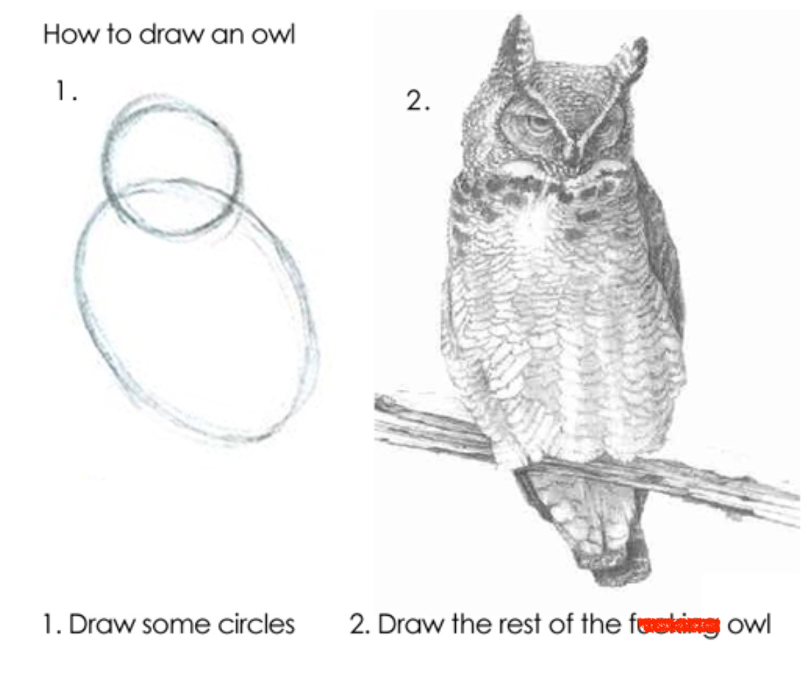
pip install nobel_prize
untitled17.ipynb
Notes:
And that’s where we come back to this image, which is Dall-E, of course – every time I see a nice image now, I just assume, oh that must be AI generated. Trying to piece together the mess of tools out there can be a pretty daunting process, and time is precious. The process of taking your untitled_notebook_17.ipynb, and navigating this hellscape to produce something decent can stressful, and the first few times, you usually make some mistakes and you just leave them, oh it’s OK, whatever. So here we stand, with our intrepid cat, ready to brave this vast landscape together. And many of the techniques that we talk about also apply to deploying production-level software. There this idea, that now you’ve developed the model you need to deploy it to production. What the hell does that even mean? Develop the model, deploy the model – it’s like that meme of how to draw an owl: you draw the two circles, and then you just draw the rest of the owl: develop the model, deploy the model.

Slide 8
Accelerate Science Programme
"Accelerate Science pursues research at the interface of AI and the sciences, generating new scientific insights and developing AI methods that can be deployed to advance scientific knowledge."
Notes:
Just before we get started, I would just like to give a brief overview of the Accelerate program.
Essentially, our driving goal is to help researchers use AI in their research. It says here that we pursue research at the interface of AI and Science, and the word science, evokes the typical STEM subjects, but actually it isn’t. We’re finding more and more that researchers from the Humanities want to utilize machine learning methods, and we’re having to reassess what we think of as traditional science.

Slide 9
Accelerate Science Programme
Workshop Goals
We want to:
Support researchers across the university to use software in their work when required.
Make best practices a core part of research
Better understand the challenges that researchers face.
Identify what training courses or software resources we might want the Accelerate Science Programme to create.
Including shared code
Start to build a community of like-minded researchers across the university.
Notes:
We are ultimately here to facilitate this process of integrating AI into research.
Just a brief about us:
I come from a Physics background, where I worked in condensed matter, thin films, and nano and atomic scale devices, and using novel devices to do machine learning. So I approached machine learning from the direction of a researcher with some coding knowledge, but then machine learning and software engineering gradually took over my life. And I’ve been down this path, tried to navigate it, had a look to see what others are doing, and what works, what’s easy, what’s not.
We run a couple of workshops at the moment: An introduction to data pipelines for machine learning, and introduction to large language models, an intro to generative AI with diffusion models, and now a packaging and publishing workshop

Slide 10
Packaging and Publishing Python Software for Research
About the course
Introduction to python packaging and publishing
Version control and GitHub Actions
Testing
Documentation
CI/CD
Code and slides available on:
Accelerate Science GitHub repo
Notes:
The aim with the courses that we run is to provide material that people can work through in their own time, but also in the context of a full day workshop event, with instructors there to help. So because this is not 8 hours, it’s only 90 minutes, we can’t work through the entire thing, so instead we’ll just touch on a few things here and of course the material is available for you to work on if you like. Please note that this is the first time we’ve run this workshop, and it’s not until May, so 1. there is still time to sign up if you like, and 2. it’s not 100% finished yet, so there may still be some minor teething issues. If you are working through it, please do feel free to either open an issue, submit a PR, or just let me know. So in a short while, I’ll introduce the material, but for now:

Slide 11
Introduction to Software Packaging and Distribution
Notes:
So first I just want to measure the temperature of the room:
How many of you have a beginner or above level of experience with version control? And by above beginner, I mean, you can initialize your own git repos locally, you can commit, you can push, you can start new github repos.
OK and intermediate and above: you can handle working on multiple branches, submit and merge pull requests, familiar with things like .gitignore, licensing.
OK, and advanced: familiar with github actions, precommit checks, continuous development and integration.
And who has published python code to either github releases or to PyPi?
Who primarily works with Jupyter notebooks? VSCode? PyCharm? Spyder? Any hipsters who are using Vim ironically or something?

Slide 12
Why is this important?
Do No Harm
Try not go beyond what is necessary to achieve a specific aim. Risk assessment should be used to prevent harms.
Safety and Security
Vulnerabilities to attack should be addressed.
Privacy and protection
Privacy must be protected throughout, and adequate data protection frameworks should be established.
Accountability
All systems should be auditable and traceable.
Transparency and explainability
The level of transparency and explainability should be appropriate so as not to conflict with privacy and safety.
Human-in-the-loop
Software systems should never replace human responsibility and accountability.
Sustainability
Assess the impact of your research on the environment.
Awareness
Public understanding of AI and data should be promoted wherever possible
Fairness
Research should promote social justice, fairness, non-discrimination, and inclusivity.
UNESCO: A Human Rights Approach to AI
Notes:
Hopefully, if you’re here, then you aren’t wondering why this is even important! But in case you are wondering….
Something that we often gloss over and don’t think about are the ethical implications of what we’re doing with our software. And it’s easy to think that sometimes nobody is going to use it, or that it won’t be deployed in the real world. And we’re not just talking about direct consequences, such as: my software is going to be used in missile guidance systems. There are potential downstream effects of developing software, and deploying it either in real world environments, or to aid scientific discovery.
Think about some recent software issues that have been in the news…poor software engineering practices literally destroys lives.
These problems can come in a variety of forms:
Bugs – bugs are just errors in the code. You think the code is doing one thing, when in actuality, it’s doing something completely different. Everything runs, and you get some coherent answers, but those answers are wrong.
Ethical issues – you’re using your code in an unethical way.
Here are the UNESCO guidelines on responsible use of AI, but they can just as easily apply to any software.
Sometimes you might see these guidelines and find it difficult to map them onto tangible actions that you can take. Some of them might be more obvious:
Sustainability. Do you really need to use an A100 GPU?
But others may not be. How do we make software systems auditable and traceable? How can we monitor security vulnerabilities? How can we be transparent and make sure our systems are explainable and interpretable? How can we ensure privacy.
Actually, the answers to some of these questions lies in proper software engineering practices.
We can make our code open source.
We can use version control, so all changes made by contributors can be tracked.
We can keep up to date with vulnerabilities via Github.
We can be aware of any third-party software, and what they are doing. An recent example is a number of quantized large language models were found to have malware or OS llm serving software platforms had phone-home software embedded in them, essentially a method to collect your information. Naughty.

Slide 13
The FAIR Principles for Research Software
Findable
Easy for humans and machines to find
Clearly versioned
Accessible
Easily retrievable via standardized protocols
Open, free and universally implementable
Interoperable
Uses data in a way that meets community standards
References appropriately
Reusable
Clear licensing
Can be understood, built upon, modified, or incorporated into other software
Introducing the FAIR Principles for research software
Notes:
We also have the fair principles for RS.

Slide 14
Why is this important?
What about some of the immediate impacts on us and our research?
Help to mitigate erroneous work.
This lessens the chance of retractions.
Gives us integrity.
Allows others to reproduce and build on our work.
Faster onboarding of new students/researchers
Notes:
The previous slide talked about the long-term, large scope impacts of software, but what about for us on the individual and group level.
Help to prevent errors. This is a big deal. I won’t ask anybody to put there hand up, but I wonder how many people in this room, have written a piece of code, and there is a part of it that they’re not quite sure how it’s working, but it does seem to be working. But how can you be sure that it’s working in the way you intend it to work?
Lessens the chance of retractions.
It gives us integrity. Your life is so much easier if you trust your own work, if you know that you’ve tugged at every thread.
It allows others to reproduce and build on our work. This is another big deal. We should, given the same starting conditions, be able to reproduce the work of other scientists to within an acceptable degree of error. And in many case in computational work, that error should be essentially machine precision.
It helps onboarding with new students. Again huge deal. How much of the initial PhD is spent deciphering the code written on stone tablets.
All comes from the end goal : publishing

Slide 15
What does it mean to “publish” software
Most researchers assume publishing means making your code repository public on platforms like GitHub.
This is certainly one of the most common forms of publishing software, and allows you to cover most of the benefits of publishing that we stated.
However, there are more sophisticated forms of publishing that can provide you with a much better chance of obtaining those advantages.
To clarify this point, I like to think of publishing as a hierarchy of publishing levels, each extra level provides you with a better chance of increasing the exposure and impact of your software.
Notes:
So what does it really mean to “publish” software?
When most people think of “publishing” code, it means to in some way make your source code available on a public platform, usually for free. For a lot of people that means uploading to GitHub. It’s akin to writing a blog on the internet. And if done correctly, which it isn’t always, it allows you to cover off a lot of the benefits of publishing we stated earlier, and also address some of the ethical issues.

Slide 16
Publishing hierarchy
Level 0: Barely doing anything. Email your source code to your colleagues/collaborators with explanations of how to run it.
Level 1: Maintain your source code publicly on GitHub under some licence. This is an important level as it now means others can fork, modify, and extend your work. However, one limitation is that most potential users of your pipeline might not be interested in your code, they just want to use your software rather than extend it.
Level 2: Publish to build repository like PyPI or Conda Forge.
Level 3: Publish documentation with something like Read the Docs or MkDocs.
Level 4: Automate all of the above!
Level 5: All of the above, and publish your pipeline or software in a software-specific journal like the Journal for Open Source Software (JOSS).

Slide 17
The Workshop
The workshop aims to take a notebook and achieve four things:
Build a user interface
We might want certain people to be able to interact with our code in a way that doesn’t involve actual coding!
Useful if working on clinical projects or with people who do not need to develop on or build on the software.
Build a command line interface
Great for ease of use – we can run a bash command, supply some arguments or config file
If you’re running software on the HPC via slurm, it makes life easier
Make our package pip installable with documentation
Automate our testing and publishing process
Notes:
And that brings us back to the workshop. So like I said at the start, we are running a full day workshop on publishing where we basically guide you through the process of taking your code and achieving four main objectives:
Firstly, building a basic user interface.
Secondly, building a CLI.
Third, making the package pip installable.
And finally, automate the testing and publishing process.

Slide 18
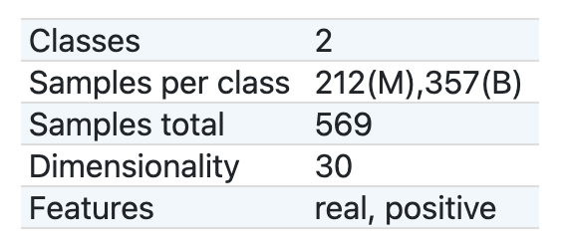
The project we will work on
Predicting cancerous tissue
Uses the UCI ML Breast Cancer Wisconsin Diagnostic dataset
A simple pipeline:
Standardize the features
Dimensionality reduction
Logistic Regression
Save the best model ready to be used by clinicians
Jupyter notebook
Python scripts
Training
Inference
CLI
Notes:
I will now introduce you to the project itself
The model and code is very simple, because the focus isn’t on the software, it’s focused on the process. So we introduce a toy model from Scikit-learn: the Wisconsin Breast cancer dataset. It’s trivial to achieve high accuracy. We do some typical exploratory data analysis
GITHUB PAGE -> NOTEBOOK -> SHOW EXTRACTED CLASS -> SHOW FINAL -> INTO CODESPACES -> ACTIVATE -> INSTALL -> UI -> CLI -> WEBSITE
Here is the main GitHub page, that is publicly available. And if you want to work through this material, you can just go to the basic code branch here.
The notebook represents the starting point for many data science and machine learning projects – a jumbled mass of code. This notebook is actually fairly well organized, but when using notebooks, you are in danger of not being aware of which code is “live” and which is not. The code itself is relatively simple for anyone familiar with basic machine learning models, it consists of some visualization, then a pipeline of standardizing, dimensionality reduction, and then logistic regression. For anyone not familiar with ML, don’t worry about.
Also included is a requirements.txt file, which is more for you so that you know what package versions you need, a saved model, and some python scripts.
One of the first steps in creating these packages is knowing how to extract functions and classes out of your notebook environments. So that’s what we do here, we create just a single class that does everything for us. Again the focus isn’t really on the software itself, it’s more what comes after, because the hope is that you can take all the other crap, and deposit your own code in it’s place, with perhaps minimal faffing around.
And then in the actual workshop itself we use GitHub Codespaces, which we’re trialing as a teaching environment. One of the biggest difficulties is that people have different operating systems, and it can be a pain to deal with windows. And so Codespaces eliminates that variable.
Obviously, this course material is designed for an 8 hour day, and not 90 minutes, but we don’t just want people to be able to attend the events, we want people to actually be able to use stuff, and work through in their own time. So to that end,
CONTRIBUTIONS WELCOME!!!!!
So something that is immediately noticeable is that at the core of all of this are two things:
Poetry
GitHub
And all of it happens within VS Code. These are really the most valuable tools for basic developing in python today. So for the remainder

